Slide 1
Lab: Git & Github

Slide 2
Git and GitHub
What is Version Control?
Version control is a system that records changes to a file or set of files over time so that you can recall specific versions later.
So ideally, we can place any file in the computer on version control.
The reason:
A Version Control System (VCS) allows you to revert files back to a previous state, revert the entire project back to a previous state, review changes made over time, see who last modified something that might be causing a problem, who introduced an issue and when, and more.

Slide 3
Git and GitHub
Using a VCS also means that if something goes wrong, like you lose files, for example, you can generally recover easily.
What is Git?
Git is a version-control system for tracking changes in computer files and coordinating work on those files among multiple people.
Git is a Distributed Version Control System. Which means Git does not necessarily rely on a central server to store all the versions of a project’s files.

Slide 4
Git and GitHub
Instead, every user “clones” a copy of a repository (a collection of files) and has the full history of the project on their own hard drive.
This clone has all of the metadata of the original while the original itself is stored on a self-hosted server or a third-party hosting service like GitHub.
Git helps you keep track of the changes you make to your code. It is basically the history tab for your code editor
If at any point while coding you hit a fatal error and don’t know what’s causing it you can always revert back to the stable state.

Slide 5
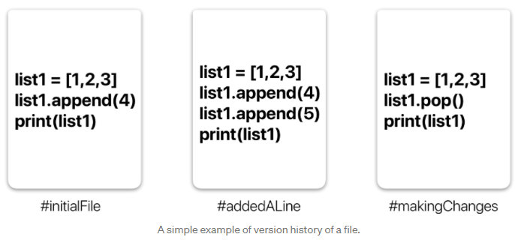
Git and GitHub
So it is very helpful for debugging. Or you can simply see what changes you made to your code over time.

Slide 6
Git and GitHub
In the example in the previous slide, all three cards represent different versions of the same file.
We can select which version of the file we want to use at any point in time. So I can jump to and fro to any version of the file in the git time continuum.
Git also helps you synchronise code between multiple people.
So imagine you and your friend are collaborating on a project. You both are working on the same project files

Slide 7
Git and GitHub
Now Git takes those changes you and your friend made independently and merges them into a single “Master” repository.
So by using Git you can ensure you both are working on the most recent version of the repository.
So you don’t have to worry about mailing your files to each other and working with a ridiculous number of copies of the original file.
And collaborating long-distance becomes easy

Slide 8
Git workflow

Slide 9
Git and GitHub
What is a Repository?
A repository a.k.a. repo is nothing but a collection of source code.
There are four fundamental elements in the Git Workflow.
Working Directory
Staging Area
Local Repository
Remote Repository

Slide 10
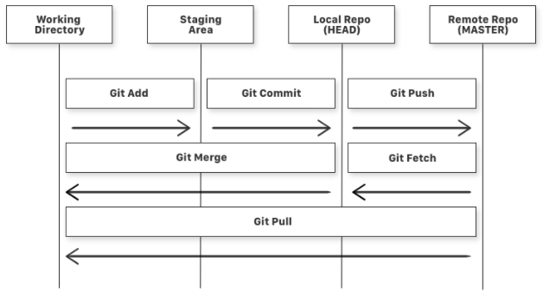
Git and GitHub

Slide 11
Git and GitHub
Consider a file in your Working Directory. It can be in three possible states -
It can be staged. This means the files with the updated changes are marked to be committed to the local repository but not yet committed.
It can be modified. This means the files with the updated changes are not yet stored in the local repository.
It can be committed. This means that the changes you made to your file are safely stored in the local repository.

Slide 12
Git and GitHub
Some further explanations -
git add is a command used to add a file that is in the working directory to the staging area.
git commit is a command used to add all files that are staged to the local repository.
git push is a command used to add all committed files in the local repository to the remote repository. So in the remote repository, all files and changes will be visible to anyone with access to the remote repository.

Slide 13
Git and GitHub
git fetch is a command used to get files from the remote repository to the local repository but not into the working directory.
git merge is a command used to get the files from the local repository into the working directory.
git pull is a command used to get files from the remote repository directly into the working directory. It is equivalent to a git fetch and a git merge .
Now that we know what Git is and its basic terminologies, let’s see how we can place a file under git. We’re going to do it the right way and the difficult way. Without any GUI applications.

Slide 14
Git and GitHub
BUT WHAT IS GITHUB?
Git is a tool. GitHub is the name of the software and the company that uses git (a tool) to give us many valuable services.
There are many git based online platforms / services. For example, GitLab, BitBucket, etc. GitHub is probably the most popular one. So this is what we will explore.

Slide 15
Getting started

Slide 16
GitHub
Go to github.com and make a free account.
Take some time to explore the website.
Create your first repository. Name it anything you like.
Once done, you will see the list of instructions to connect this repository to your code in your computer. Ignore it for now.
Create a folder named gitHello (or anything).
In it, dump some of your codes. Or create a bunch of text files and place them in the folder.

Slide 17
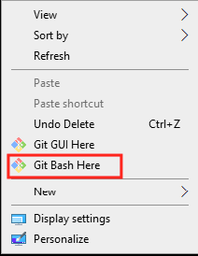
GitHub
Download git in your machine from here.
Install git by following the installer. Go with the default options.
When done, a restart may be required.
Now, you can test installation by right clicking in a folder -
Type git --version

Slide 18
GitHub
Now we need to connect this with your github account.
For that, open git bash and type these commands -
  git config --global user.name "YourName"
  git config --global user.email "TestEmail@mail.com"
  git config --global --list (To check the info you just provided)

Slide 19
GitHub
Now you would be prompted to enter your credentials every time you push or pull, so we use this command -
  git config --global credential.helper "cache --timeout=14400"
This caches your password for the duration of this class (4 hours).
But you can’t store it for ever since the password is stored in plain text which is not secure.
The perfect solution is to set up SSH keys, which we will do later.

Slide 20
Next steps...

Slide 21
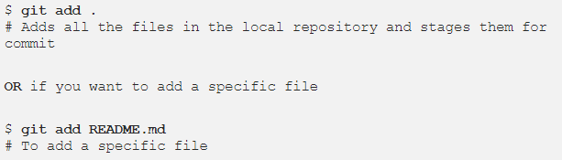
GitHub
Navigate to gitHello folder and right click anywhere. Select git bash here.
Try this -

Slide 22
GitHub
Let’s see what files are staged -
  git status # Lists all new or modified files to be committed
Commit changes to your git repo -
  git commit -m "First commit"
  # The message in the " " is given so that the other users can read the message and see what changes you made
Now files are in the local repository (head)

Slide 23
GitHub
Now each time you make changes in your files and save it, it won’t be automatically updated on GitHub.
All the changes we made in the file are updated in the local repository. Now to update the changes to the master:
Add the origin, i.e., where to put the code -
  git remote add origin remote_repository_URL (only needed for
Then upload it to the origin
  $ git push -u origin master # pushes changes to origin

Slide 24
GitHub
Now check out your repository in github website. You will find your code there.
Once you start making changes on your files and you save them, the file won’t match the last version that was committed to git. To see the changes you just made:
  git diff # To show the files changes not yet staged

Slide 25
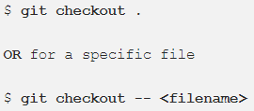
GitHub
Now you can choose to revert back to the last committed version by entering:
You can use the git log command to see the history of commits you made to your files: git log

Slide 26

GitHub
Each time you make changes that you want to be reflected on GitHub, the following are the most common flow of commands:
Now if we go and see our repo, we can identify whether the commit was successful by looking at the commit message for each file.

Slide 27
Working on other repos

Slide 28
GitHub
Cloning a Git Repo:
Locate to the directory you want to clone the repo. Copy the link of the repository you want and enter the following:
  git clone remote_repository_URL
Try it with this repo (or any other repo).
Now you can work on the files you want and commit to changes locally.
If you want to push changes to that repository you either have to be added as a collaborator, which we will discuss later.

Slide 29
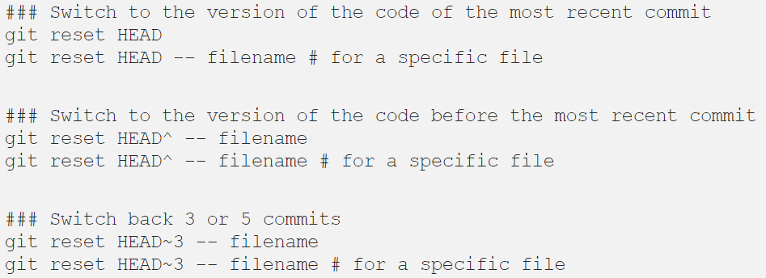
GitHub
Fixing mistakes and backtracking

Slide 30
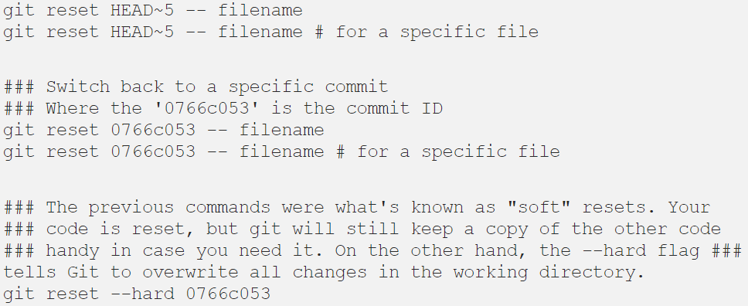
GitHub
Fixing mistakes and backtracking

Slide 31

GitHub
One more thing is the .gitignore file.
.gitignore tells git which files (or patterns) it should ignore.
It's usually used to avoid committing transient files from your working directory that aren't useful to other collaborators, such as compilation products, temporary files IDEs create, etc.
A sample gitignore file may look like this -

Slide 32
GitHub
Ignore all files that -
Have any name with extension .cmake
Have any name with extension .DS_Store
Is exactly name .user
Is exactly named build
To exclude directories, we write -
/folderName/

Slide 33
Collaborating on github

Slide 34
GitHub
You’re a team player, so you’re going to need to add your team to your repo so they can collaborate.
Once your team is added as collaborators they’ll be able to push, merge, and a ton of other destructive things so make sure you’re only adding your teammates.
Click on the “Settings” tab of your rep, then “Collaborators” then search for Github users and add them by clicking “Add Collaborator”:

Slide 35
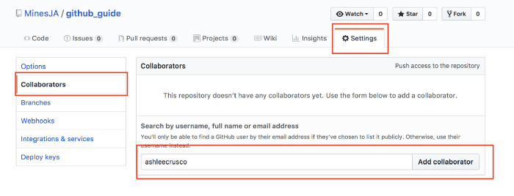
GitHub

Slide 36
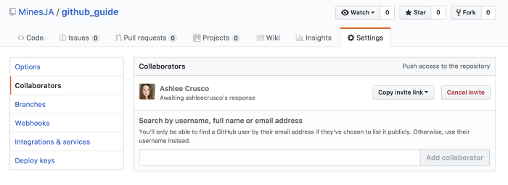
GitHub
They’ll receive an email letting them know you added them and will be listed as a collaborator.

Slide 37
GitHub
If you’re a collaborator, go to the Github Repo page, Git Clone the project, and cd into the directory.
Don’t fork it! Forking will copy it in a new Repo to your Github page, but you don’t want that — you want to collaborate on the same Github Repo with your teammates.
Now go to your folder of choice on your machine and type this command in git bash - git clone <repo url>
Now you are ready to collaborate.

Slide 38
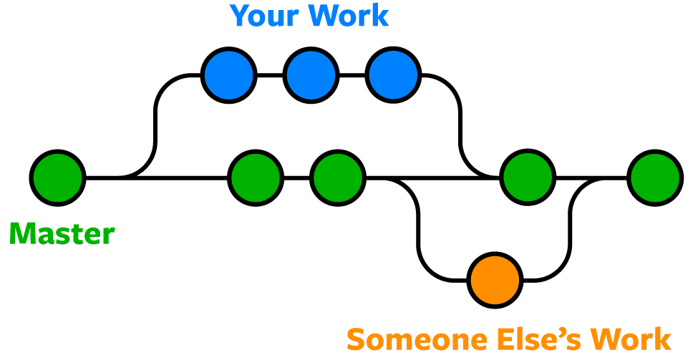
GitHub
For collaboration, you and your teammates would be working on different branches. Branches are literal branches in your workflow.

Slide 39

GitHub
By default, we have everything on the master branch. Let’s say we have this in readme.md in master branch -
Now, in order to add a new feature, you would create a new branch. Say develop branch -

Slide 40
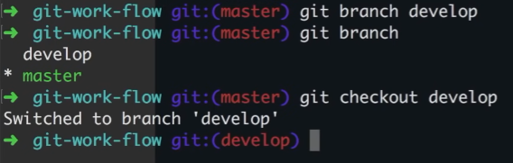
GitHub
Create a branch
Check existing branches (We are in master branch now)
Switch to develop branch

Slide 41
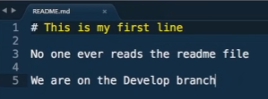
GitHub
Now, make necessary changes in develop branch and hit git add and commit.
If you want to push to remote repo, then type git push -u origin develop

Slide 42
GitHub
You will get the following error -
fatal: The current branch dev has no upstream branch.
The error is self explanatory. To fix it, try this (for first time only) -
git push --set-upstream origin develop

Slide 43

GitHub
Now if you ever want to rollback to master branch, you can do that by -
git checkout master
Notice how the contents of the file have changed.

Slide 44
GitHub
If you want to add another feature independent of the master branch, then
Git checkout master
Git branch newFeature
Git checkout newFeature
In newFeature, you will start out with the code as it was in master
Now you and your teammate can work together in different branches

Slide 45
GitHub
But let’s say that you think develop branch has too much work and would like someone to help you.
In that case, you can create another branch from develop branch -
Git checkout develop
Git branch newFeature2
Git checkout newFeature2
Now you start out with the code as it was in develop branch -

Slide 46
GitHub
When you are done with working on a branch, you would want to merge them with master.
To merge newFeature2 with develop -
Git checkout develop
Git pull
Git merge newFeature2
Git push -u origin develop

Slide 47
GitHub
To merge develop with master -
Git checkout master
Git pull
Git merge develop
Git push -u origin master
Before merging, you should ALWAYS test the branch in question thoroughly.
The idea is that the master branch should always be deployable and should not contain any work in progress.

Slide 48
Resolving conflicts

Slide 49

GitHub
Sometimes two developers will change the same line of code in two different ways; in such a case, Git can't tell which version is correct—that's something only a developer can decide.
If this happens, a developer will see the following error during a git merge:

Slide 50


GitHub
In a branch "branch_to_create_merge_conflict", lets say the readme.md file is as shown below
In master branch -

Slide 51

GitHub
Now when you try
  Git checkout master
  Git merge branch_to_create_merge_conflict
You get -

Slide 52
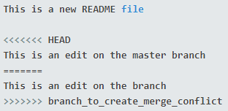
GitHub
So you go to readme.md and witness the ugliness -
As you can see, Git added some syntax including seven "less than" characters, <<<<<<< and seven "greater than" characters, >>>>>>>, separated by seven equal signs, =======. These can be searched using your editor to quickly find where edits need to be made.

Slide 53
GitHub
That there are two sections within this block:
  The "less than" characters denote the current branch's edits (in this case, "HEAD," which is another word for your current branch), and the equal signs denote the end of the first section.
  The second section is where the edits are from the attempted merge; it starts with the equal signs and ends with the "greater than" signs.
As a developer, you decide what stays and what goes. Make your edits as necessary, then close the file:

Slide 54

GitHub
Now -
Git add .
Git commit -m “merged successfully”
Git push -u origin master
Notice that if you run into serious issues, you can abort the merge by running git merge --abort to abort the merge.

Slide 55
Resources
An article on basic git commands -
Basic Git Commands Every Developer Should Know (Git & Github)
An interactive game that teaches git branching -
Learn Git Branching

Slide 56
THANK YOU

